Slide 1
Honeypot File Forensic Monitoring System
BY:SHREYA V

Slide 2
ABSTRACT
The project presents a file-based honeypot that detects and logs unauthorized file access.
It automatically generates forensic reports, captures events in SQLite, and creates PCAP files for Wireshark.
A Chain of Custody mechanism ensures integrity of digital evidence.
The system helps investigators analyze insider threats effectively using Python automation on Kali Linux.

Slide 3
Existing System
Antivirus/IDS monitor malware, not insider misuse.
Event logs are technical & hard to analyse.
No instant alert/report for file access.
Integrity verification (hash proof) missing.

Slide 4
Proposed System
Introduces a forensic honeypot that monitors file access in real time.
Automatically creates forensic reports and network captures.
Maintains a structured SQLite database and evidence chain.
Uses Python automation to integrate monitoring, reporting, and blocking.
Lightweight and runs entirely on open-source tools in Kali Linux.

Slide 5
SYSTEM REQUIREMENTS
Hardware Requirements:
Processor: Intel Core i3 or above
RAM: 4 GB (minimum)
Software Requirements:
OS: Kali Linux / Ubuntu
Language: Python 3.10+
Database: SQLite3
Tools: inotify-tools, ReportLab, Scapy, Rich, Wireshark

Slide 6
Modules:
1. File Monitoring Module
This module keeps an eye on the honeypot file all the time.If anyone tries to open, edit, or delete the file, this module detects the action immediately.It uses a Linux tool called Inotify to track these file activities in real time.
2. Event Logging & Database Module
When an unauthorized action is detected, this module records all the details — like the time, user, action type, and file hash — in a SQLite database.This helps investigators check what happened, when, and who did it later.
3. Network Capture Module
This module captures network packets whenever an attack or file access happens.It uses a tool called Scapy to collect this data, which can then be analyzed in Wireshark.This helps to see if the attacker tried to send data over the network.
4. CLI Dashboard Module
This module shows a dashboard view of all activities directly in the terminal.It displays recent logs, file status, and alerts in a neat and colorful format using the Rich Python library.

Slide 7
FUTURE ENCHANCEMENTS
Add AI-based detection to identify suspicious user behavior.
Enable email or SMS alerts for instant notifications.
Integrate cloud storage for secure evidence backup.
Add digital signatures for Chain of Custody reports.
Extend support to Windows and macOS platforms.

Slide 8
Conclusion
Project demonstrates insider attack detection using honeypot.
Provides forensic-ready evidence (hash, logs, reports).
Lightweight implementation suitable for low-end systems.
Can be extended with alerts or network honeypots in future.

Slide 9
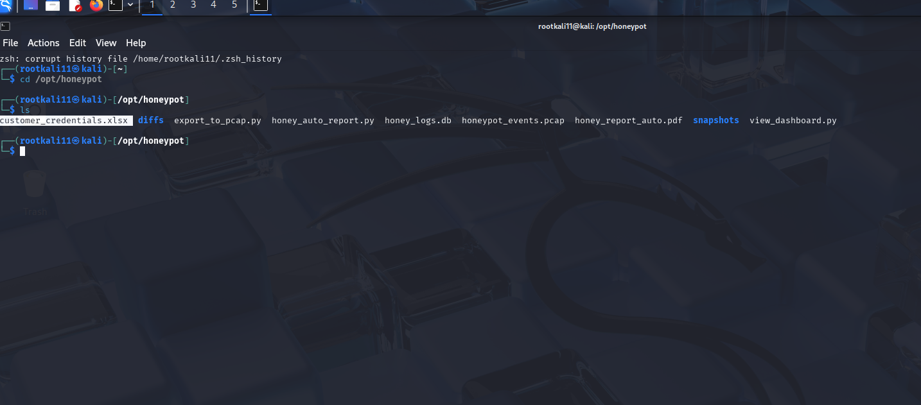
CREATING HONEYPOT FILE
In kali linux ,created the honeypot file (customers_crendentials.xlsx) basic mkdir(/opt) ,touch command.
Installing python3-pip.

Slide 10
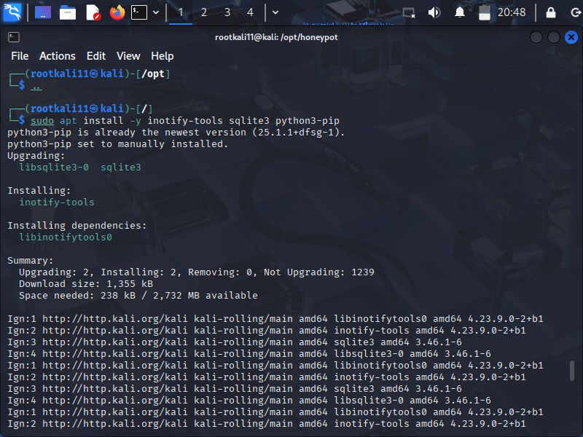
Installing Requirements
Inotify tools
Sqlite3
ReportLab
Scapy
Rich for CLI dasboard

Slide 11
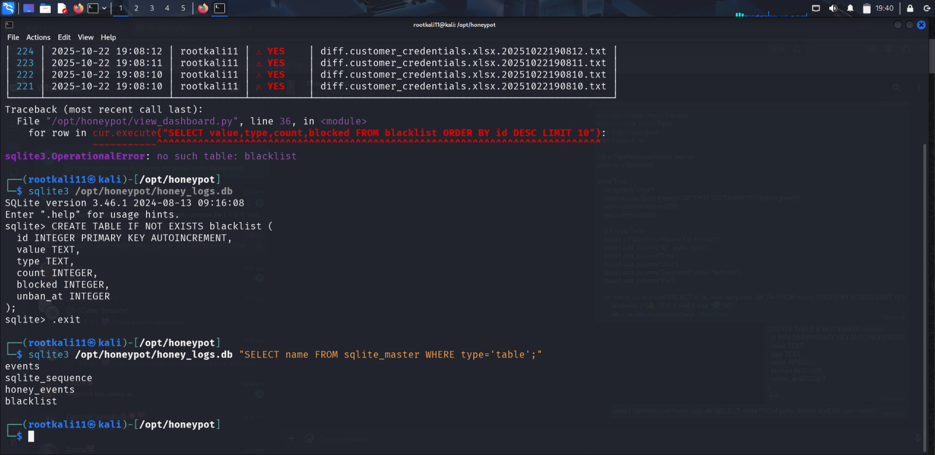
Creating the Database
Sqlite3 /opt/honeypot/honey_logs.db
The query “.tables SELECT*FROM events; .exit”.
Created honey_logs.db

Slide 12
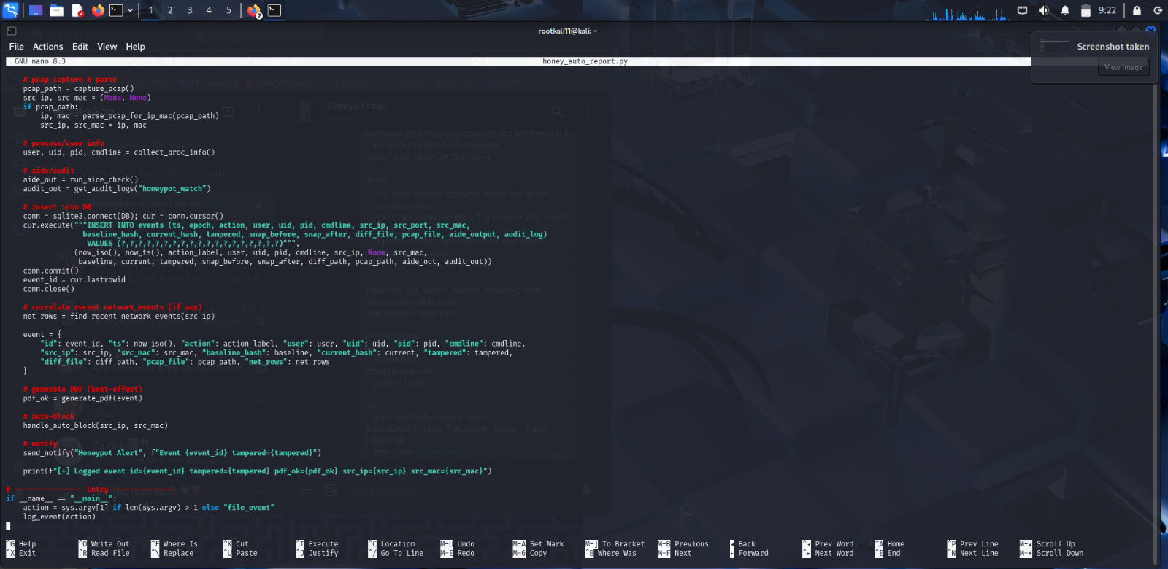
Monitor Script
Creating python monitor script.
Inotify triggered the python script.

Slide 13
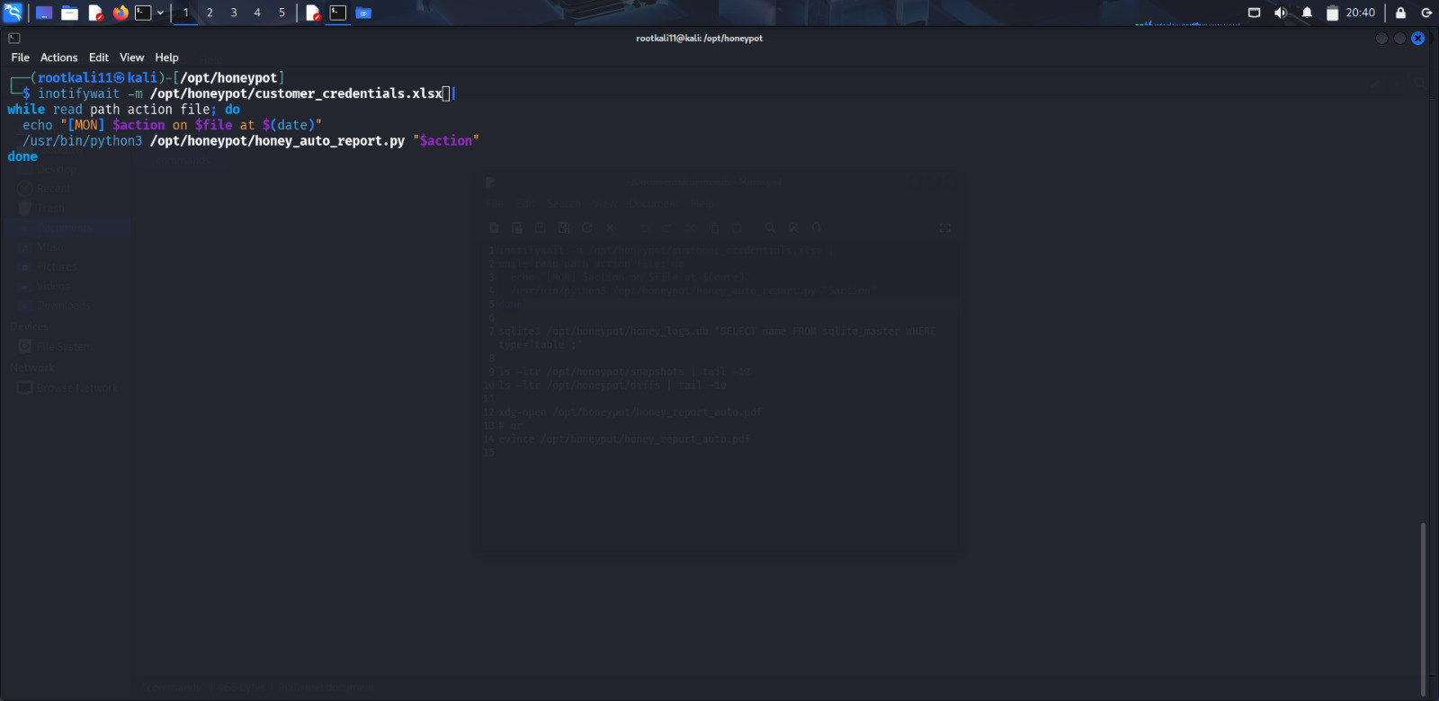
Inotify Trigger
Monitor the customers_crendentials.xlsx
To create the pdf and with the help of honeypot monitor script python.

Slide 14
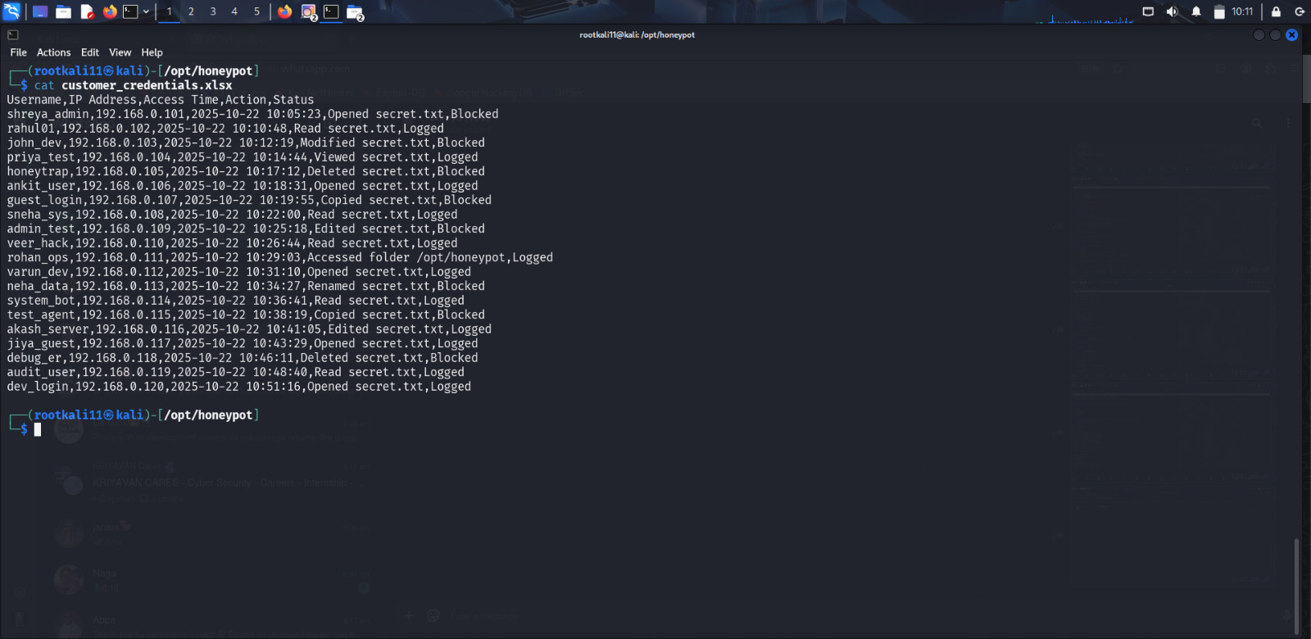
Attacker Terminal
In Another Terminal is considered as the Attacker Terminal.
In Attacker Terminal is accessed the honeypot file they read or modify

Slide 15
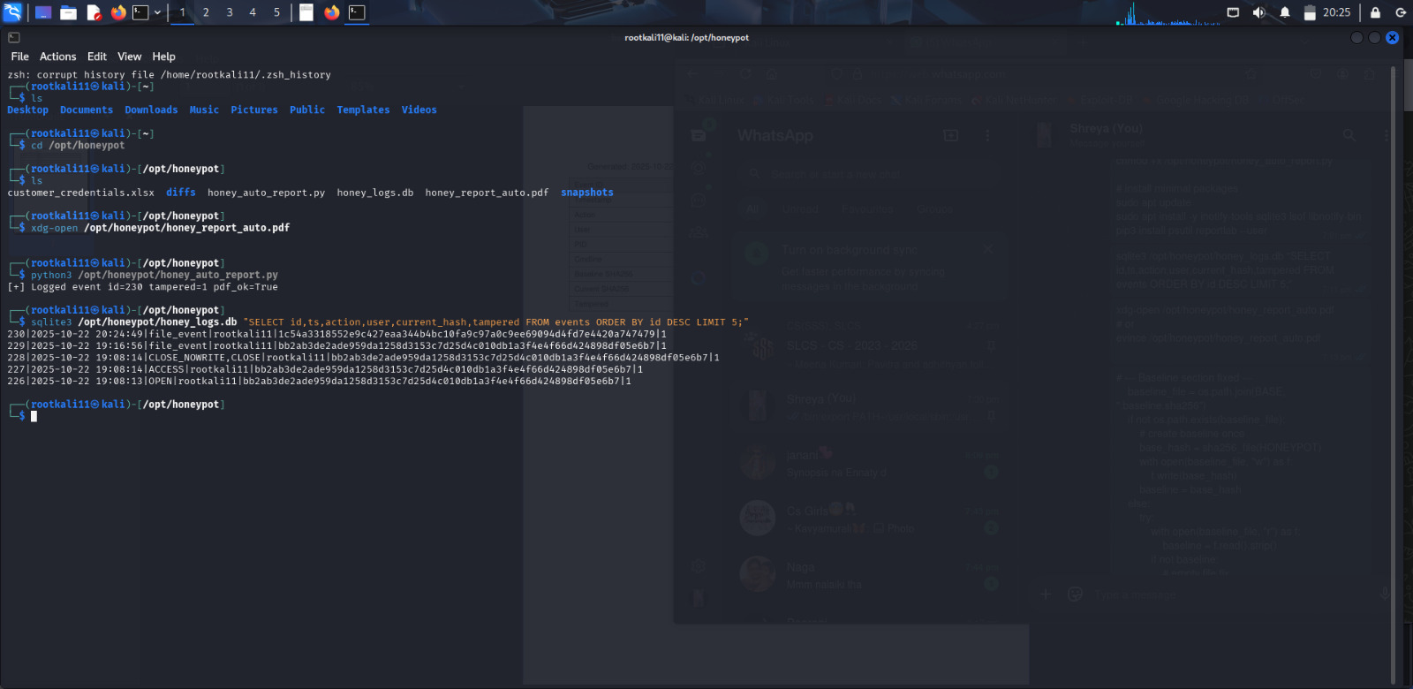
Check the logs
Sqlite3 honey_logs.db”SELECT id,ts,action,user,current hash,tampered from events.
Then run python3 honey_auto_report.py

Slide 16
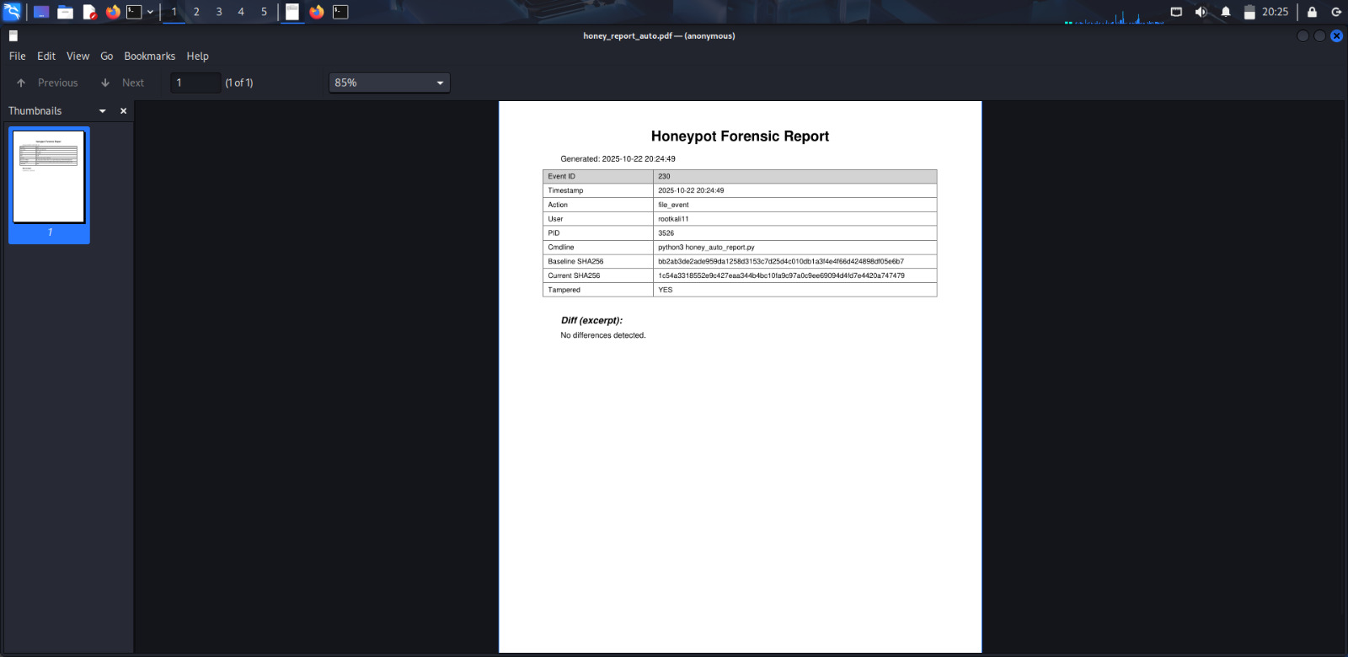
PDF Generation
Honey_auto_report.pdf are automatic created once the run monitor script
To view the pdf command help of xdg-open honey_auto_report.pdf

Slide 17
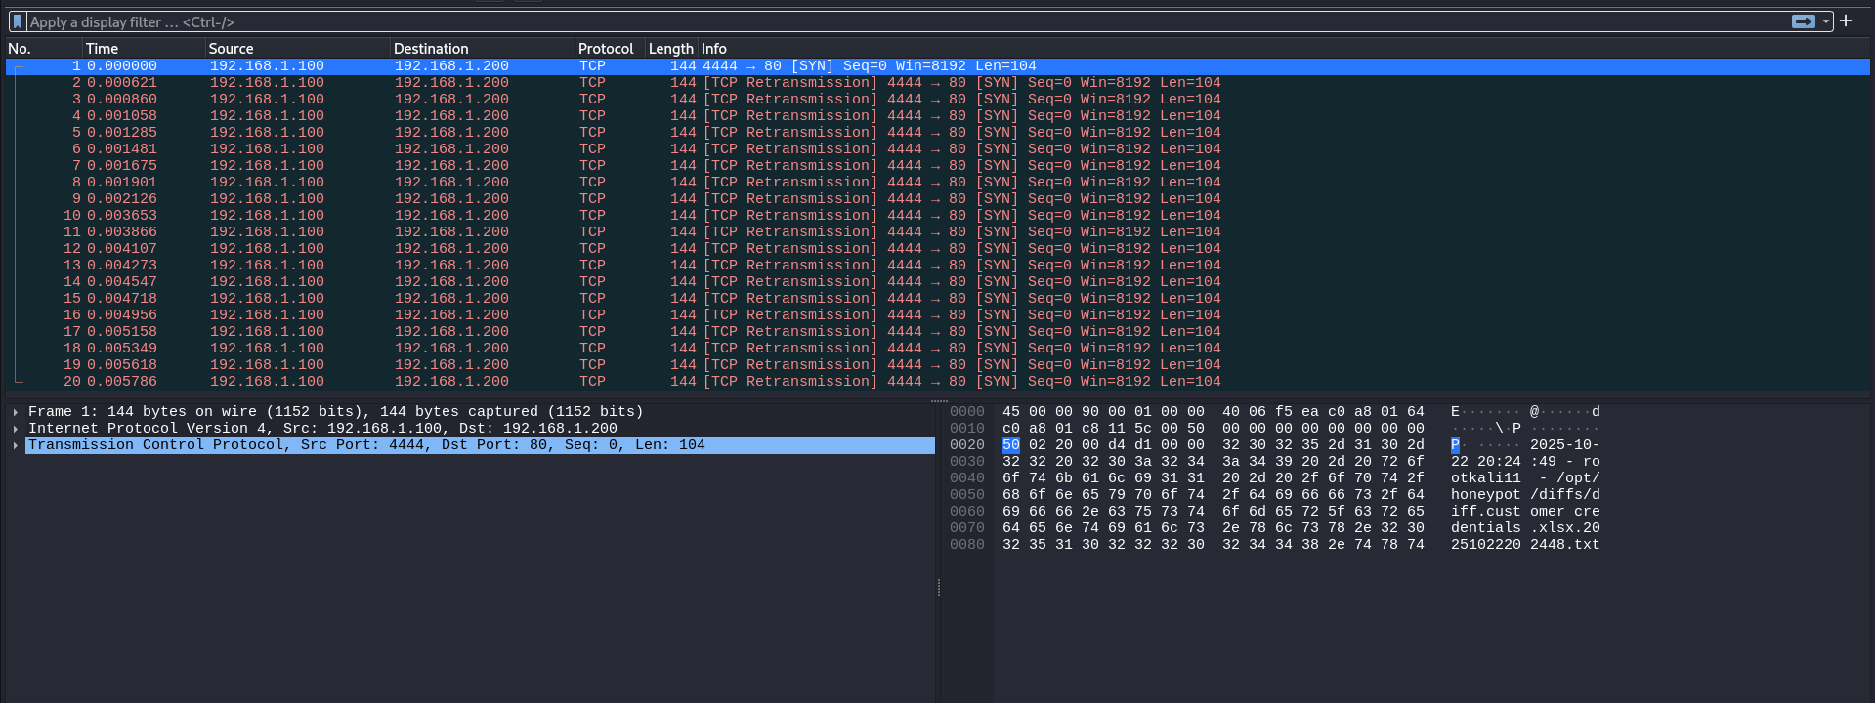
To analyse the PCAP file for wireshark

Slide 18
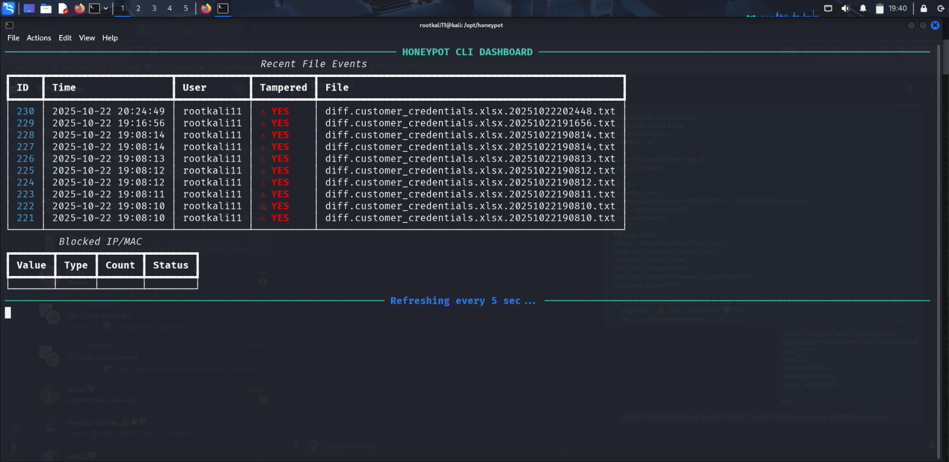
Dashboard
To Show the Dashboard then run view_dashboard.py
Displayed CLI Dashboard

Slide 19
THANK YOU

